Slide 1

RAILWAY RESERVATION SYSTEM (Online Train Ticket Booking)

Slide 2
ABC INSTITUTE OF TECHNOLOGY AND RESEARCH
Guided By: Presented By:
Prof. AAAAAAA BBBBBBBB
CCCCCCCCCCC

Slide 3
DEVELOPERS
BBBBBBBBB
CCCCCCCCC

Slide 4
ABSTRACT
The main aim of the project was to develop a website which would facilitate the reservation of online train tickets through an effective and yet simple GUI for a normal passenger intending to travel in trains. Apart from reserving tickets, through our system a passenger can compare online fares ‘from’ one city ‘to’ other cities.

Slide 5
MODULES
Booking: The system can book online tickets of the passengers, where they want to go.
Cancellation: The passengers can cancel their train tickets as usually.
Passenger Details: The System stores all the necessary information of the passengers.

Slide 6
MODULES
Trains: It shows the train schedule such as bus time, arrival and departure time etc.
Search:
This is provided the search options of the system that can search any related information of the system.
Report:
This shows the reports in different fields of the system.

Slide 7
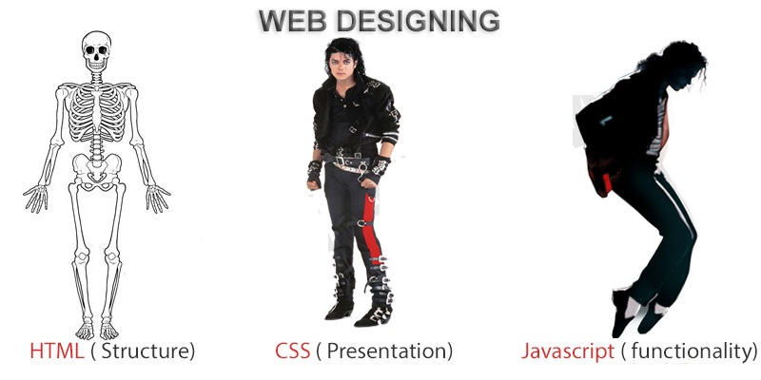
FRONTEND (LANGUAGE USED)
HTML (HYPERTEXT MARKUP LANGUAGE)
CSS (CASCADING STYLE SHEET)
BOOTSTRAP (FRAMEWORK OF CSS AND JS)

Slide 8

BACKEND
PYTHON DJANGO
SQLITE (DATABASE)

Slide 9
SOFTWARE USED
PYTHON INTERPRETER
PYCHARM IDE (INTEGRATED DEVELOPMENT ENVIRONMENT)
NOTEPAD++ OR ANY OTHER TEXT EDITOR
CHROME OR ANY OTHER BROWSER

Slide 10
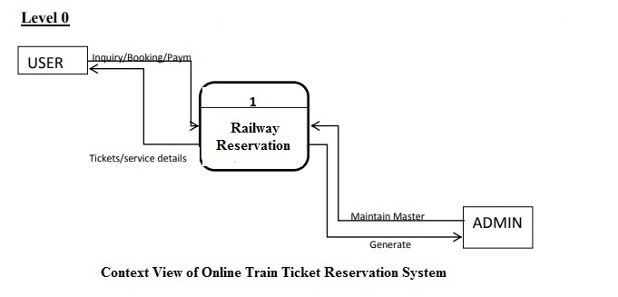
DFD(DATA FLOW DIAGRAM) Level - 0

Slide 11
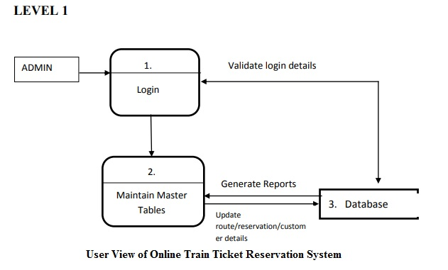
DFD(DATA FLOW DIAGRAM) Level - 1

Slide 12
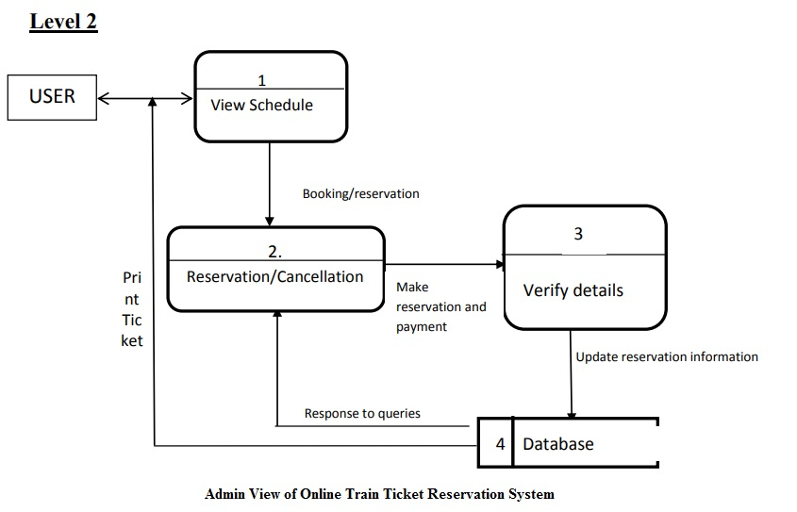
DFD(DATA FLOW DIAGRAM) Level - 2

Slide 13
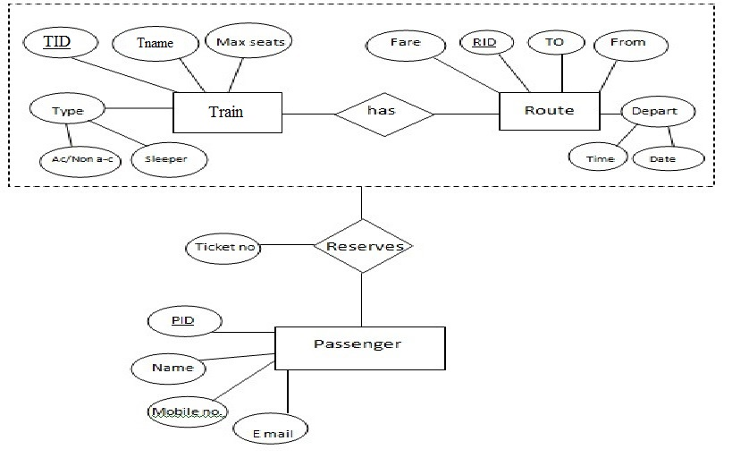
ER DIAGRAM

Slide 14
USE CASE DIAGRAM
Use case diagram consists of use cases and actors and shows the interaction between them. The key points are:
The main purpose is to show the interaction between the use cases and the actor.
To represent the system requirement from user’s perspective.
The use cases are the functions that are to be performed in the module.
An actor could be the end-user of the system or an external system.

Slide 15
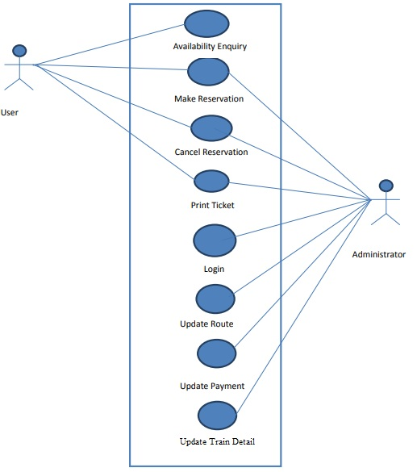
USE CASE DIAGRAM

Slide 16
SEQUENCE DIAGRAM
Login
Application
Database
Login
:Request
:Validate()
:executeQuery()
Response
Show Result
Failed:show()

Slide 17
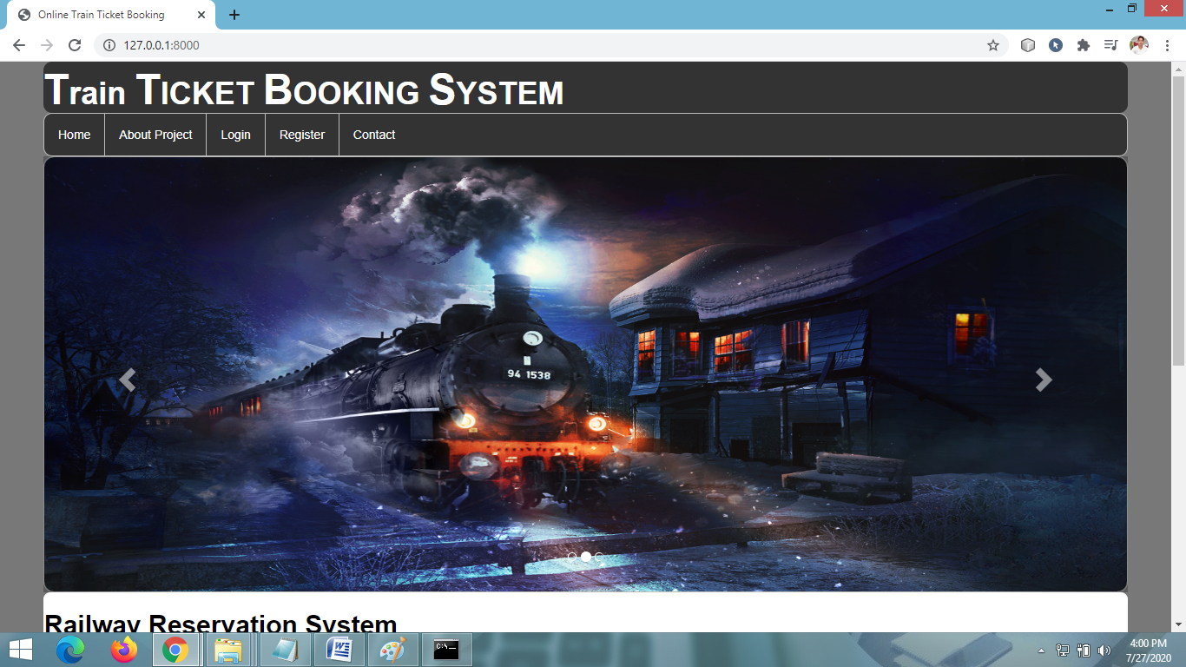
HOME PAGE

Slide 18
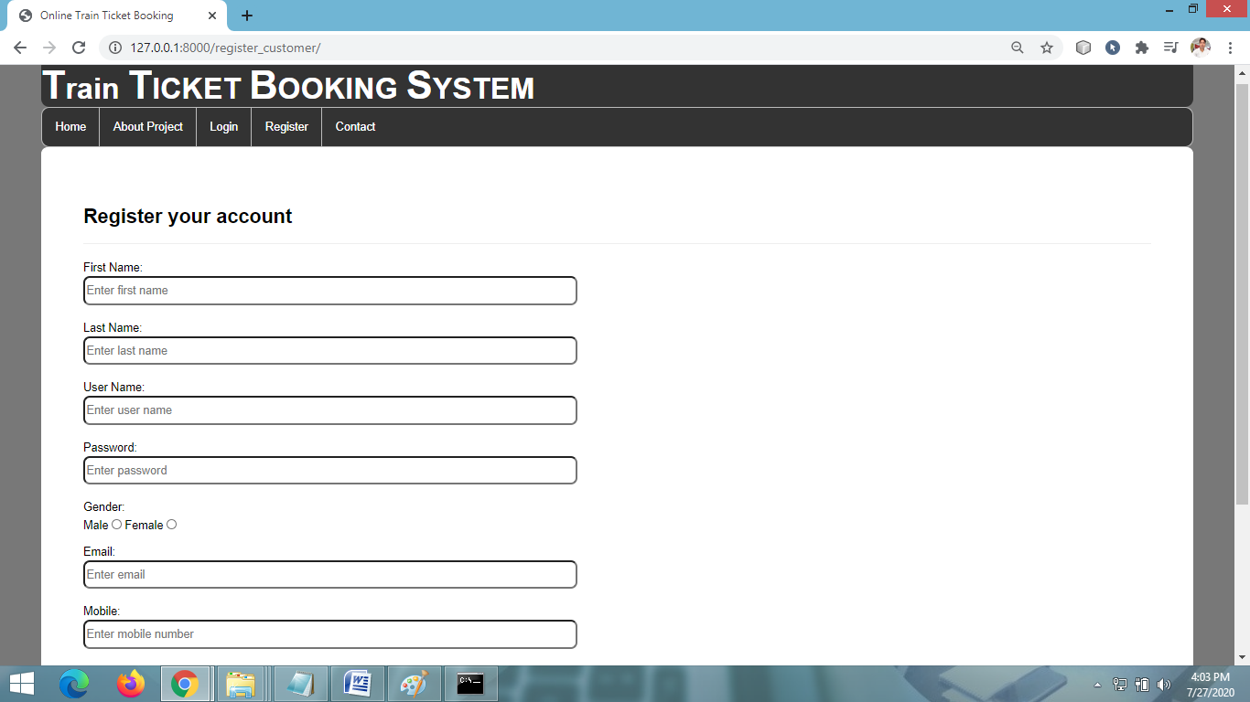
USER REGISTRATION PAGE

Slide 19
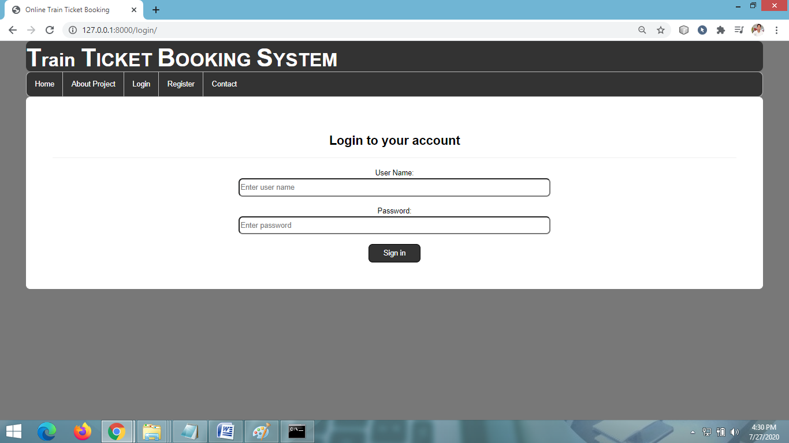
LOGIN PAGE

Slide 20
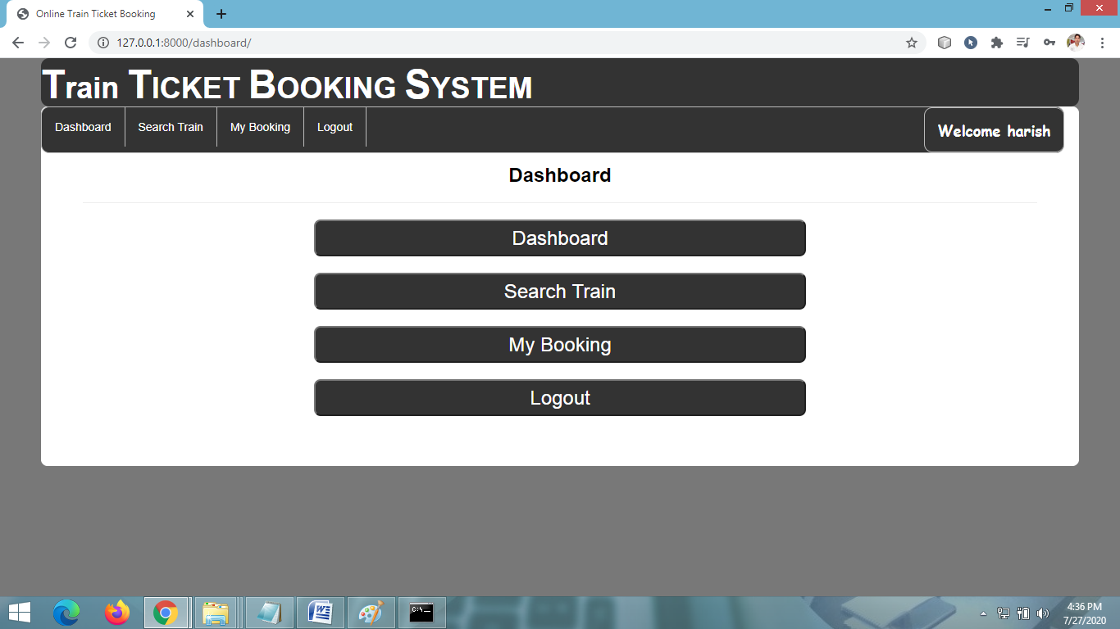
USER DASHBOARD

Slide 21
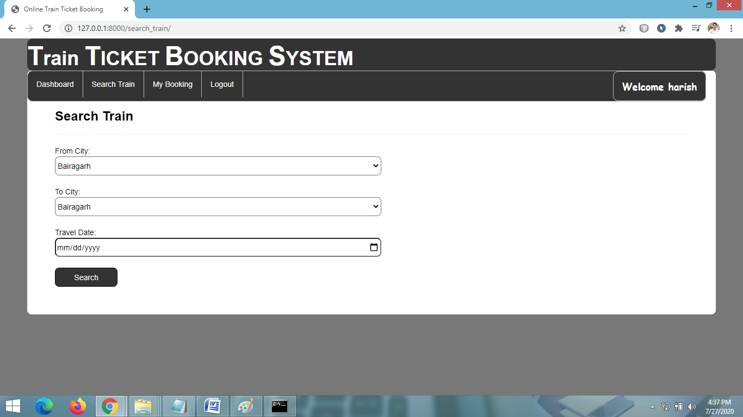
SEARCH TRAIN

Slide 22
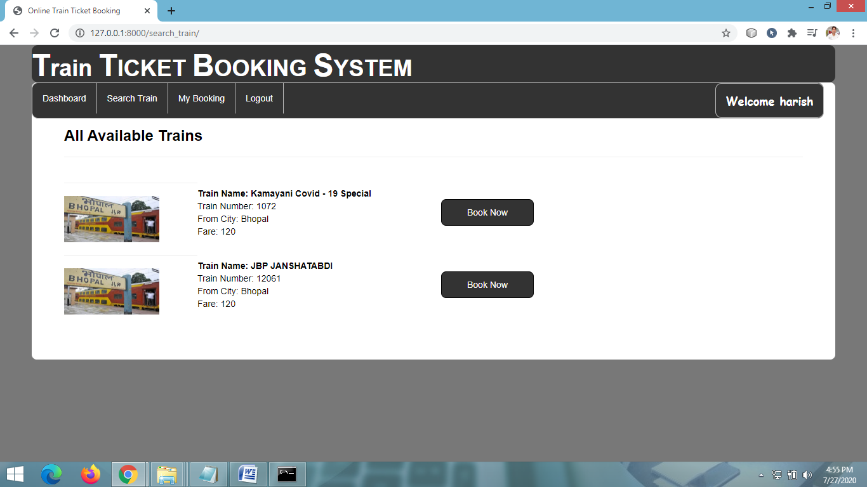
VIEW AVAILABLE TRAIN

Slide 23
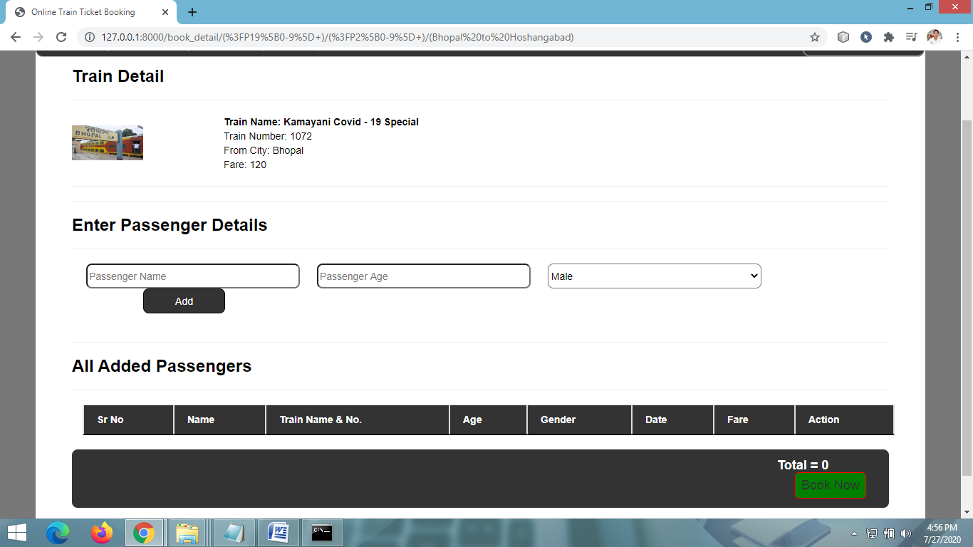
ENTER PASSENGER DETAILS

Slide 24
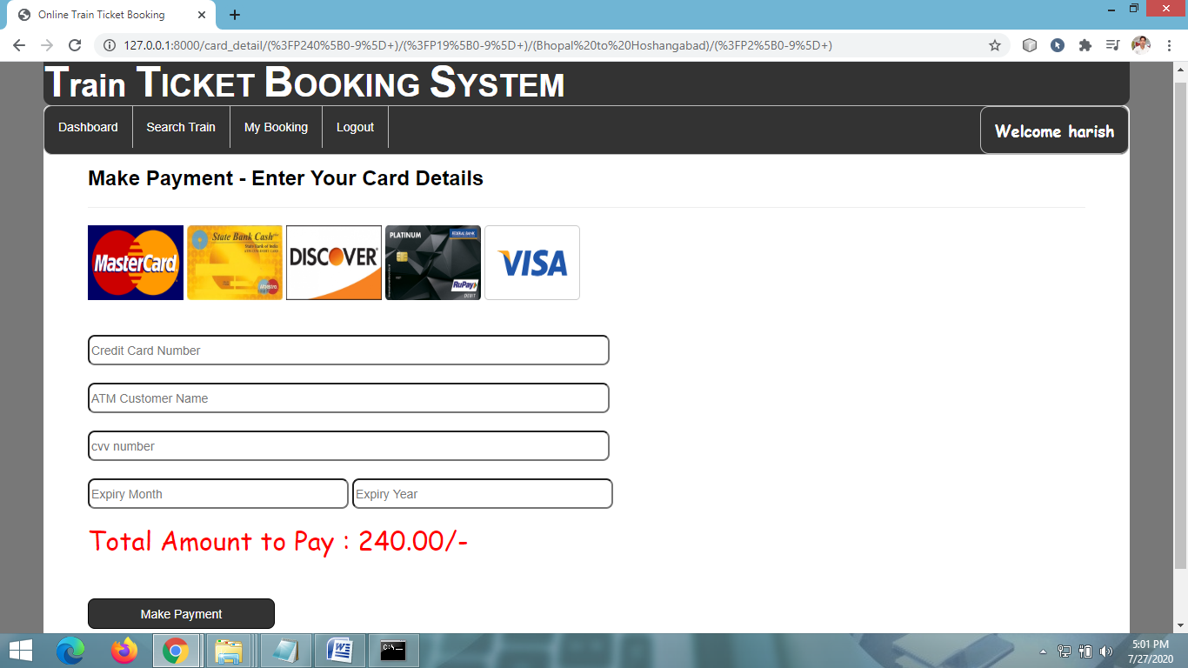
MAKE PAYMENT PAGE

Slide 25
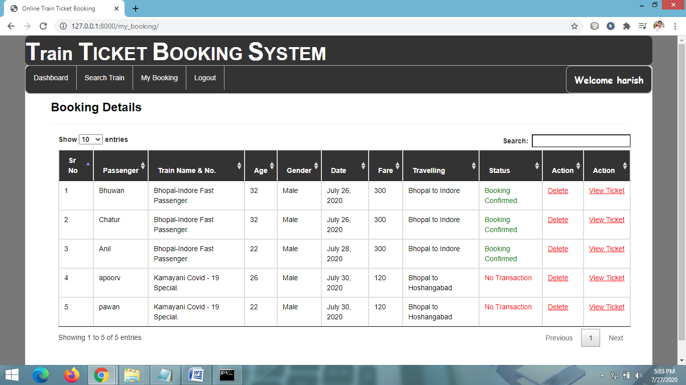
BOOKING DETAILS(User)

Slide 26
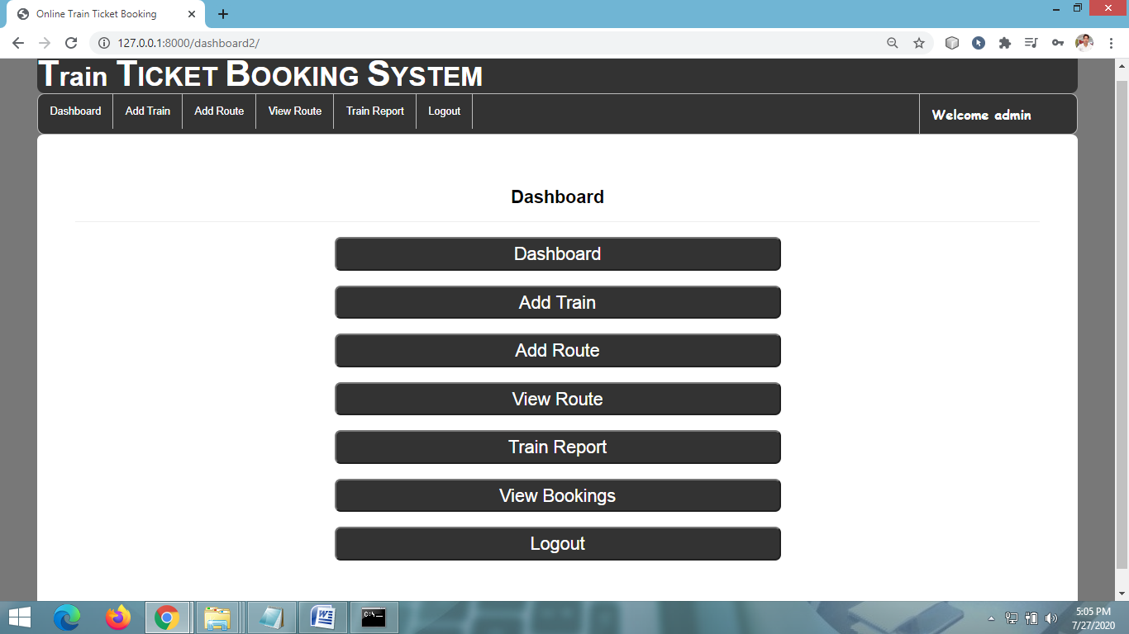
ADMIN DASHBOARD

Slide 27
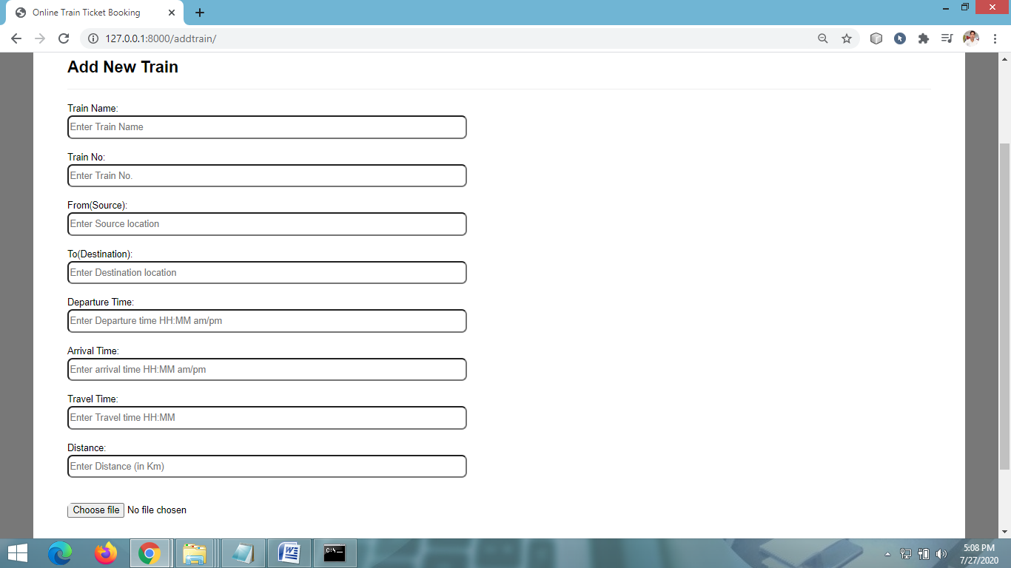
ADD NEW TRAIN DETAIL PAGE

Slide 28
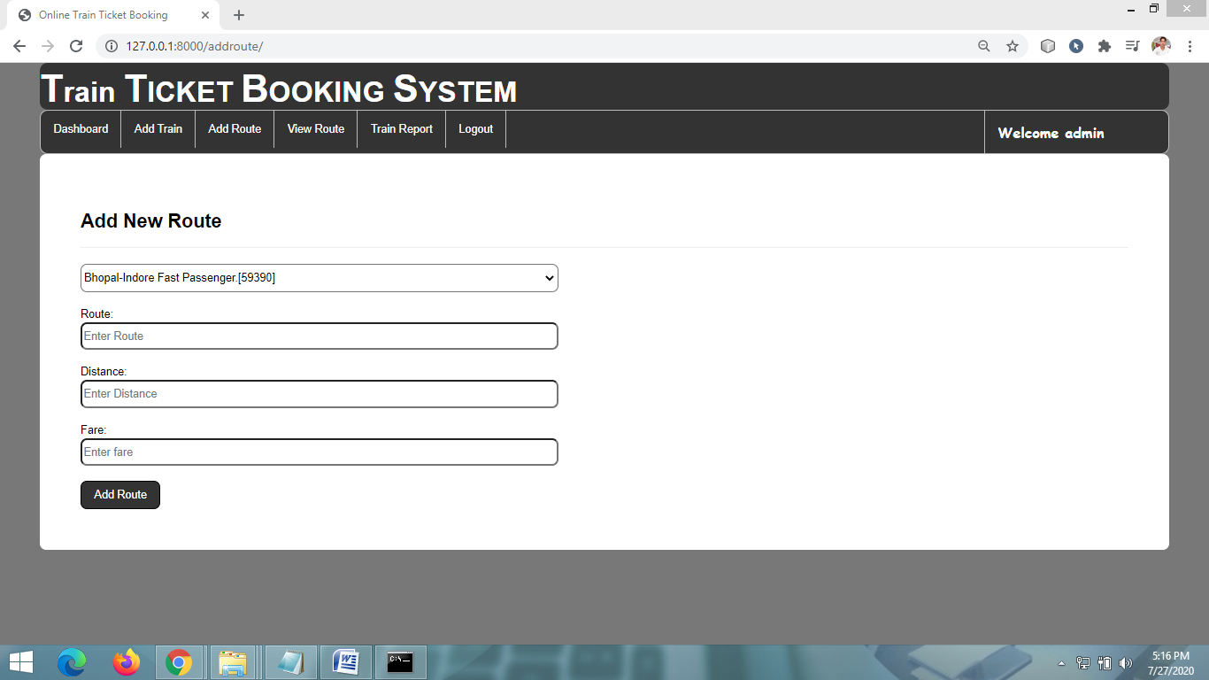
ADD NEW TRAIN ROUTE PAGE

Slide 29
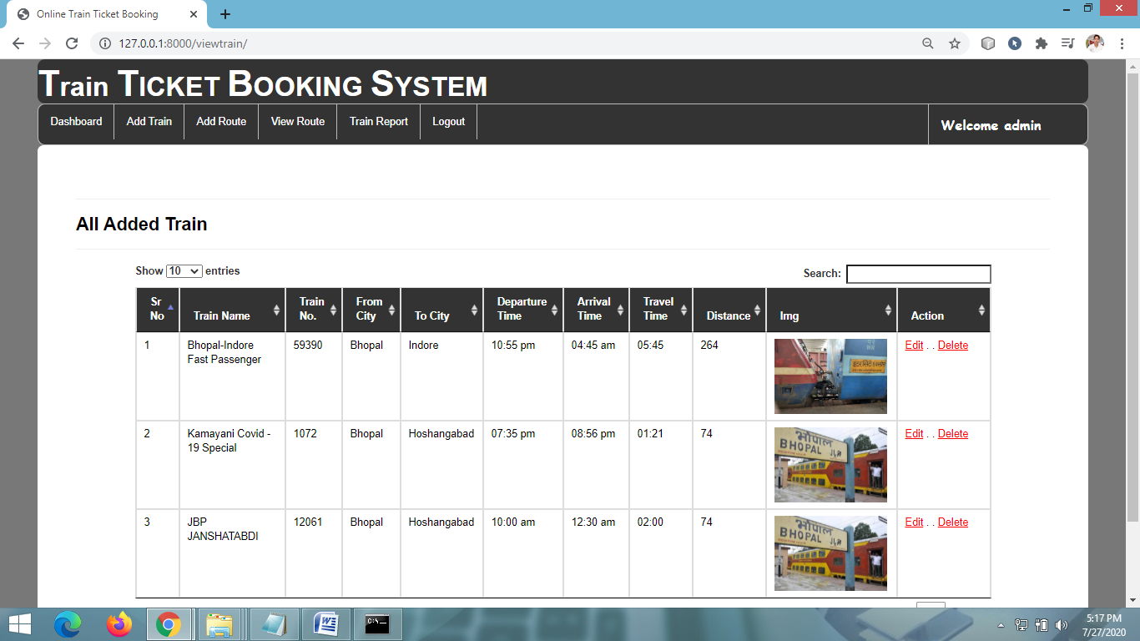
VIEW ALL TRAIN DETAILS PAGE

Slide 30
CONCLUSION & FUTURE SCOPE
FUTURE SCOPE
This web application involves almost all the features of the online train ticket booking. The future implementation will be online help for the customers and chatting with website administrator.
CONCLUSION
The project entitled “Online Train Ticket Booking” is developed using HTML, CSS and Bootstrap as front end and Python Django and Sqlite database in back end to computerize the process of online bus ticket booking. This project covers only the basic features required.

Slide 31
BIBLIOGRAPHY
FOR PYTHON INSTALLATION
https://www.python.org
FOR HTML , CSS ANF PYTHON BASICS
www.w3schools.com
www.javatpoint.com
https://www.geeksforgeeks.org/python-django/
REFERENCE BOOKS
Two scoops of Django for 1.11 by Daniel Greenfeld’s and Audrey Greenfield
Lightweight Django by Elman and Mark Lavin

Slide 32
THANKYOU

